Slide 1
One focus of Unit one is on the development and expansion of the world’s three major monotheistic religions.
What is monotheism?
The belief in just one God
So . . . What do you think polytheism is (remember your stem words!)
The belief in many gods—as in all of the ancient civilizations such as Egypt and Greece
Hale Bopp Comet over the Pyramids of Giza

Slide 2
Georgia Performance Standard SS7G8
The student will describe the diverse cultures of the people who live in Southwest Asia.
Jerusalem: a holy city to all three religions

Slide 3
SS7G8c: Compare and contrast the prominent religions in Southwest Asia (Middle East): Judaism, Islam, and Christianity.
Judaism is the oldest monotheistic religion, founded circa 1900 BCE, when Abraham was called to leave his home in Ur and travel to Cannan (later known as Palestine and Israel).
Abraham is regarded as the father of the Jewish people.
Abraham is the father of the Israelites. It is with Abraham that God makes his covenant and promise. This is a stained glass window at St. Anne’s Belfast Cathedral in Northern Ireland.

Slide 4
SS7G8c: Compare and contrast the prominent religions in Southwest Asia (Middle East): Judaism, Islam, and Christianity.
Jews believe God made a covenant with Abraham that his descendants would be God’s chosen people. In return they would have to keep God’s laws.
God gave the Jewish people the 10 Commandants and other rules to live by (contained in the Torah, the first five books of the Bible), marking the beginning of Judaism as a structured religion.
What is the Torah known as?
The main religious text of the Jewish religion.
The Torah scrolls that are read in a synagogue are unpointed text, with no vowels or musical notes, so the ability to read a passage from a scroll is a valuable skill, and usually requires a lot of practice

Slide 5
SS7G8c: Compare and contrast the prominent religions in Southwest Asia (Middle East): Judaism, Islam, and Christianity.
Abraham’s descendants multiplied as the twelve tribes of Israel and entered Egypt, where they were eventually enslaved.
Moses led the Jews out from captivity in Egypt.
Jewish civilization after the exodus prospered in the kingdoms of Israel and Judah, originally headed by powerful kings like Saul, David and Solomon, who built the first great temple in Jerusalem.
What it may have been like fishing with Moses. ☺

Slide 6
Jewish beliefs cont.
The name for a Jewish place of worship is a synagogue.
The Hebrew word for God is Yahweh.
The magnificent Great Synagogue of Budapest, Hungary.

Slide 7
Has anyone heard of these Jewish Holidays?
Rosh Hashanah: The beginning of the Jewish New Year
Yom Kippur: The Day of Atonement, the last 10 days of penitence which marks the opening of the New Year.
Hanukkah: An eight day festival which commemorates the re-dedication of the temple in Jerusalem after expelling the occupying Syrians in 164 BCE
Passover : Week long memorial retelling the Israelites’ release from Egypt
Bar Mitzvah: Coming of age for boys aged 13. In liberal traditions, an equivalent ceremony (Bat Mitzvah) is carried out for girls
Shabbat (Sabbath): Day of rest, worship and fasting, from sunset Friday to sunset Saturday
At the age of 13, a Jewish boy reads the Torah for the first time and promises to keep God's commandments

Slide 8
Assignment – Homework if not completed in class
You must include these concepts and underline them:
Name of followers
place of origin
Founder
place of worship
titles of religious figures
At least 2 religious holidays
Write a journal entry assuming the role of a Jewish person living in Jerusalem
Minimum 15 sentences
Write this on a separate piece of paper

Slide 9
SS7G8c: Compare and contrast the prominent religions in Southwest Asia (Middle East): Judaism, Islam, and Christianity.
Christianity takes its name from the Greek word ‘Christ’, meaning Anointed One, whom Christians believe was Jesus, the son of God.
Jesus was born in Bethlehem, near Jerusalem (both considered holy cities by Christians) and grew up as a Jewish boy.
At about the age of 30 he began three years of traveling and teaching. He taught a new way of drawing upon the Jewish tradition.

Slide 10
SS7G8c: Compare and contrast the prominent religions in Southwest Asia (Middle East): Judaism, Islam, and Christianity.
Jesus was a Jewish teacher and prophet who lived in Palestine in the first century CE. (Christianity founded circa 30 CE)
He revealed himself to be the Son of God in fulfillment of Hebrew scripture, and taught that the Kingdom of God was imminent, bringing with it forgiveness and new life for all who believed.
The yellow areas show the spread of Christianity from 200 CE to 400 CE.

Slide 11
Have you heard of these Christian holidays and festivals?
Advent: The beginning of the Christian Year. Four Sundays before Christmas, Christians set aside time for reflection and preparation for recalling the coming of Christ.
Christmas (December 25): The celebration of Jesus’ birth
Lent: The 40 days of preparation and penance which begins on Ash Wednesday and concludes at sundown on Holy (Easter) Saturday.
Easter: The holiest period of the Christian calendar. It begins with Good Friday, which solemnly commemorates Jesus’ crucifixion, and continues until Easter Sunday which celebrates the resurrection of Jesus.
The holy book of Christianity is the Bible and the place of worship for Christians is a church and/or cathedral.

Slide 12
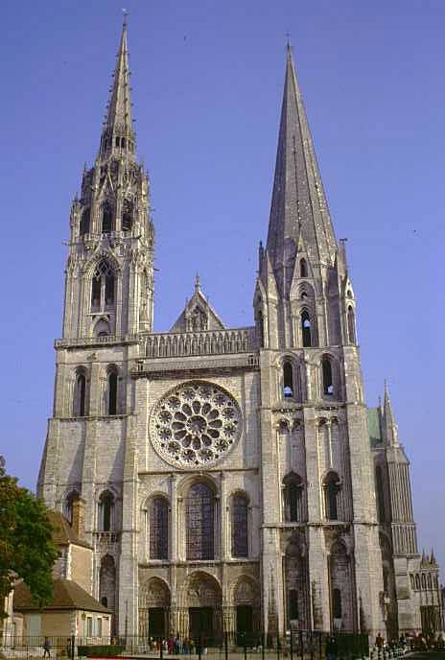
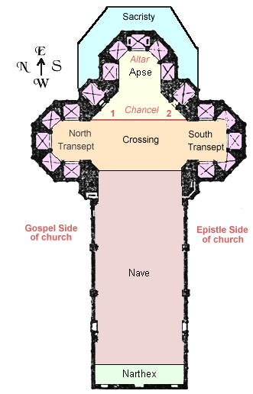
Cathedrals

Slide 13
Assignment – Make sure you follow ALL the directions!
Write a letter to a friend in the mind of a Christian. The letter should be about how you came across a Jewish individual and the events that transpired.
Minimum 15 sentences on a separate sheet of paper.
Underline key concepts!
Concepts discussed must include ALL OF THE FOLLOWING: Holidays, monotheistic, holy book, founders, places of worship, and any other differences/similarities.

Slide 14
SS7G8c: Compare and contrast the prominent religions in Southwest Asia (Middle East): Judaism, Islam, and Christianity.
Islam means submission to Allah (God). Islam was revealed to the Prophet Muhammad (the founder of Islam) who lived from 570 CE to 632 CE in Mecca (a holy city for Islam along with Jerusalem) in modern-day Saudi Arabia.
Muhammad was called to prophethood when God dictated the Qur'an to him through the archangel Gabriel.
Although he gained a small following in his tribe, Muhammad was initially persecuted for his beliefs.
Location of the holy city of Mecca in Saudi Arabia

Slide 15
SS7G8c: Compare and contrast the prominent religions in Southwest Asia (Middle East): Judaism, Islam, and Christianity.
In 622 CE he fled to what is now known as Medina, where the first Muslim political community was formed. The Muslim calendar dates from this journey, known as the Hijrah.
The Ka’aba at the Grand Mosque in Saudi Arabia

Slide 16
SS7G8c: Compare and contrast the prominent religions in Southwest Asia (Middle East): Judaism, Islam, and Christianity.
Muhammad continued receiving messages from God throughout the later part of his life. He memorized these messages and passed them on to his followers. After his death they were collected and written down in the Qur’an (Koran).
The sayings and deeds of Muhammad were recorded in the Hadith. These two books are the source of guidance for all Muslims.
The Qur’an, holy text of Islam. Notice the geometric design on the cover. That is a trademark of Islamic art.

Slide 17
Have you heard of any of these Islamic holidays or festivals?
Ramadan: Celebrates the gift of the Qur'an. During the month of Ramadan, Muslims must fast between sunrise and sunset.
Hajj: The month of pilgrimage during which all Muslims, at least once in their life, should try to make the pilgrimage to Mecca.

Slide 18
SS7G8c: Compare and contrast the prominent religions in Southwest Asia (Middle East): Judaism, Islam, and Christianity.
In this political cartoon, why is this man’s question silly?
Hey, Jack! Which way's Mecca?

Slide 19
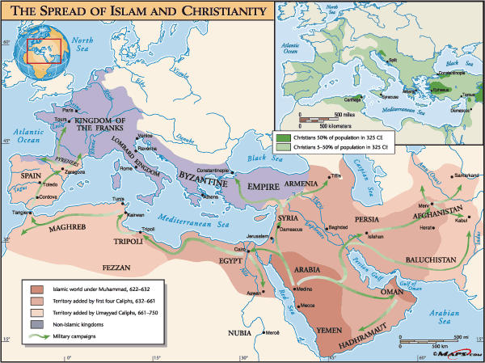

Slide 20
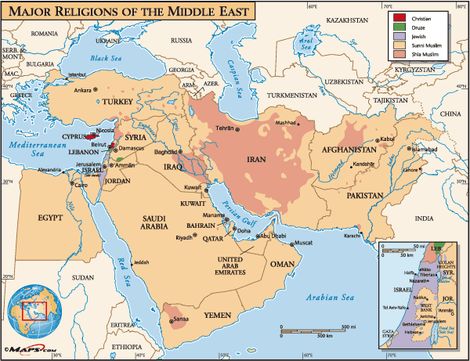

Slide 21
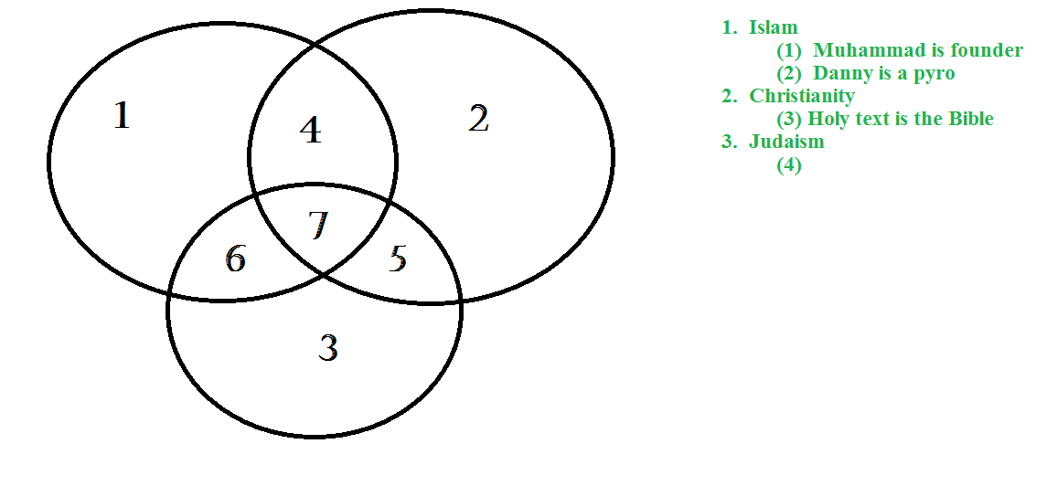
Assignment – due in 8 minutes
Make sure your Triple Venn Diagram is EXACTLY how I want it.
It needs to be comparing/contrasting the three different monotheistic religions.
Make sure to have 20 TOTAL – I won’t accept anything less!

Slide 22
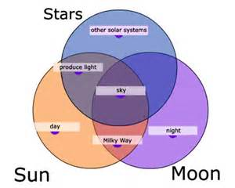

Slide 23
The practice of religious faith is also built on The Five Pillars of Islam:
Shahadah (declaration of faith): "I bear witness that there is no god, but God; I bear witness that Muhammad is the prophet of God." By reciting this, one enters Islamic faith.
Salaah (prayer): Muslims are required to pray five times a day and facing in the direction of Mecca while praying.
Zakat (charity): Muslims are required to give away a percentage of their earnings to those less fortunate, regardless of their religion.
Saum (fasting): Muslims fast for one lunar month each year, a period called Ramadan. During this time, Muslims reflect on their behavior and strive to purify their thoughts.
Hajj (pilgrimage): If it is financially possible, Muslims are required to travel to Mecca once in their lifetime.

Slide 24
SS7G8d: Explain the reason for the division between Sunni and Shia Muslims.
Caliph: Means “successor,” the title given to those who took over leadership of the Umma (the Muslim community) after the death of Muhammad. The practice of the caliphs is called the Caliphate.
Sunni Islam: The followers of Sunni Islam make up the vast majority of Muslims, roughly 85 percent. Sunnis believe that Mohammed did not appoint a successor, and therefore one had to be appointed by the Muslims themselves. This led to the establishment of the Caliphate, a series of men who took over Mohammad's worldly power, but made no claim to be Mohammad's spiritual successor.
Shia Islam: The Shiites believed that Mohammed had designated Ali as his successor and spiritual heir. There are two important aspects here. First, the idea that Mohammad's heir should be from Mohammad's family. Second, that unlike the Sunnis, the successor should be a religious and political leader.

Slide 25
Assignment
Work individually or with a partner to complete the following task:
You must demonstrate the similarities/differences between a Sunni Muslim and a Shia Muslim.
Be sure to highlight their belief on who should be Caliph as well as their overall population percentage!!!!!!!!!!!!!!
This can be done through the following methods: Graphic Organizer (Venn Diagram) – Write out a play/short story – Rap Song (better be decent) – Cartoon Strip.
You have 20 minutes to have this completed. Be prepared to present your work.

